Slide 1
Bitmasking

Slide 2
Tables of Content
What is Bit ?
What is Bit Masking?
Set Representation Using Bitmask
Basic Bitwise Operations
Set/Clear Bit, Toggling Bit Values
Examples
LSB, MSB
Application Of Set Operations

Slide 3
What is Bit ?
A "bit" in data structure refers to the smallest unit of data in computing and digital information. The term "bit" is an abbreviation of "binary digit," and it can have one of two values: 0 or 1.
Bits are used to represent the most fundamental unit of information and are the building blocks for all digital data.

Slide 4
What is Bit Masking?
Definition: Bit masking is a fundamental technique that involves manipulating individual bits within binary representations of numbers.
Bit masking relies on bitwise operations like AND, OR, and XOR.
Importance: Bit masking enable memory optimization and efficient algorithms. It is often used for tasks such as setting, clearing, or checking specific bits within a binary number

Slide 5
Set Representation Using Bitmask
Let us suppose we have a set S consisting of N items numbered from 1 to N. Set S can be represented as follows, S = 1, 2, 3, ..., N.
Bitmasking is a way in which every subset of S can be represented with the help of a number in its binary form. To represent a set of N items we need a sequence of N bits where every bit represents an item in the Set. This sequence of bits used to represent a subset of a set is usually referred to as a mask. For example, the sequence of bits 10101 is a mask used to represent a set of size 5.

Slide 6
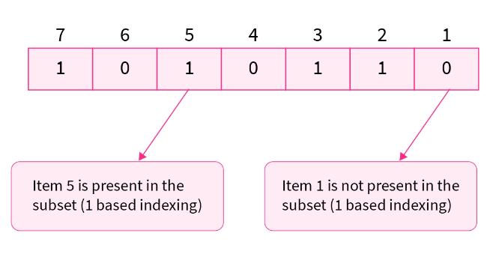
Cont.
In a particular subset if the i^th bit in the mask is set or is equal to 1 that means that the i^th item is included in the subset.
If the i^th bit is unset or is equal to 0 that means that the i^th item is not included in the subset.
For example, the mask 1010110 represents a subset of a set having 7 items (number of bits in the mask) including items 2,3,5,7 (1 based indexing).

Slide 7
Basic Bitwise Operations
The & (bitwise AND) in C or C++ takes two numbers as operands and does AND on every bit of two numbers. The result of AND is 1 only if both bits are 1.
The | (bitwise OR) in C or C++ takes two numbers as operands and does OR on every bit of two numbers. The result of OR is 1 if any of the two bits is 1.
The ^ (bitwise XOR) in C or C++ takes two numbers as operands and does XOR on every bit of two numbers. The result of XOR is 1 if the two bits are different.

Slide 8
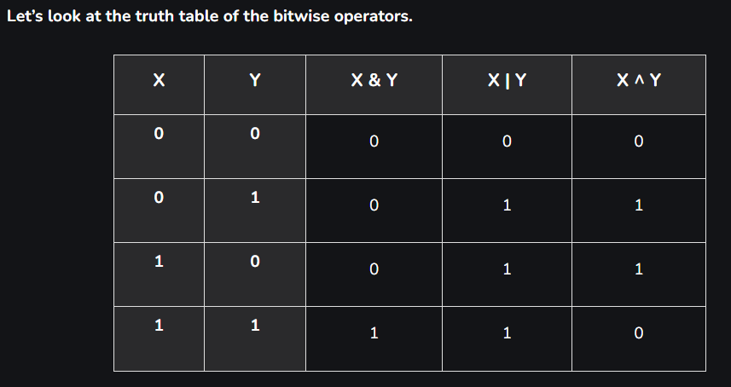
Basic Bitwise Operations​:

Slide 9
Set, Clear and Toggle
Setting a bit means that if K-th bit is 0, then set it to 1 and if it is 1 then leave it unchanged.
1
Clearing a bit means that if K-th bit is 1, then clear it to 0 and if it is 0 then leave it unchanged.
2
Toggling a bit means that if K-th bit is 1, then change it to 0 and if it is 0 then change it to 1.
3

Slide 10
Setting a bit
Since we all know that performing bitwise OR of any bit with a set bit results in a set bit, i.e.
Any bit <bitwise OR> Set bit = Set bit
which means,
0 | 1 = 1
1 | 1 = 1

Slide 11
Clear bit example:
Input: N = 5, K = 1
Output:
Setting Kth bit: 5
Explanation:
5 is represented as 101 in binary
Its first bit 1, so
Setting it will result in 101 i.e. 5.
Note: Read binary bit from right to left

Slide 12
Clearing a bit
Since bitwise AND of any bit with a reset bit results in a reset bit, i.e.
Any bit <bitwise AND> Reset bit = Reset bit
which means,
0 & 0 = 0
1 & 0 = 0

Slide 13
Clear bit example:
Input: N = 5, K = 1
Output:
Setting Kth bit: 5
Clearing Kth bit: 4
Explanation:
5 is represented as 101 in binary
Its first bit 1, so
Setting it will result in 101 i.e. 5.
Clearing it will result in 100 i.e. 4.
Note: Read binary bit from right to left

Slide 14
Toggle a bit
Since XOR of unset and set bit results in a set bit and XOR of a set and set bit results in an unset bit. Hence performing bitwise XOR of any bit with a set bit results in toggle of that bit, i.e.
Any bit <bitwise XOR> Set bit = Toggle
which means,
0 ^ 1 = 1
1 ^ 1 = 0

Slide 15
Toggle bit example:
Explanation:
5 is represented as 101 in binary
Its first bit 1, so
Setting it will result in 101 i.e. 5.
Clearing it will result in 100 i.e. 4.
Toggling it will result in 100 i.e. 4.
Input: N = 5, K = 1
Output:
Setting Kth bit: 5
Clearing Kth bit: 4
Toggling Kth bit: 4
Note: Read binary bit from right to left

Slide 16
Another example:
Suppose you have an 8-bit binary number (byte) and you want to perform this three bit masking operations on it:
Setting a Bit: You want to set the 3rd bit (counting from the right, with 0-based indexing) to 1 without affecting the other bits.
Clearing a Bit: You want to clear (set to 0) the 6th bit.
Toggling a Bit: You want to toggle the 5th bit.

Slide 17
Solution:
Setting a Bit: You want to set the 3rd bit (counting from the right, with 0-based indexing) to 1 without affecting the other bits.
1. Setting a Bit:
To set the 3rd bit (counting from the right) to 1, you can use the bitwise OR operation with a mask that has only the 3rd bit set to 1:
Original Number: 00101100 Bit Mask: 00000100 Result: 00101100 (unchanged bits) OR 00000100 (3rd bit set) = 00101100

Slide 18
Solution:
Clearing a Bit: You want to clear (set to 0) the 6th bit.
2. Clearing a Bit:
To clear the 6th bit (counting from the right), you can use the bitwise AND operation with a mask that has only the 6th bit set to 0 (all other bits set to 1):
Original Number: 00101100
Bit Mask: 11110111
Result: 00101100 (unchanged bits) AND 11110111 (6th bit cleared) = 00100100

Slide 19
Solution:
Toggling a Bit: You want to toggle the 4th bit.
3. Toggling a Bit:
To toggle the 4th bit (counting from the right, with 0-based indexing) of a binary number, you can use the bitwise XOR operation with a mask that has only the 4th bit set to 1:
Original Number: 00101100
Bit Mask: 00001000
Result: 00101100 (Original Number) XOR 00001000 (4th bit toggled) = 00100100

Slide 20
More example:
Explanation:
7 is represented as 111 in binary and has its second bit 1, so
Setting it will result in 111 i.e. 7.
Clearing it will result in 101 i.e. 5.
Toggling it will result in 101 i.e. 5.
Input: N = 7, K = 2
Output:
Setting Kth bit: 7
Clearing Kth bit: 5
Toggling Kth bit: 5
Note: Read binary bit from right to left

Slide 21
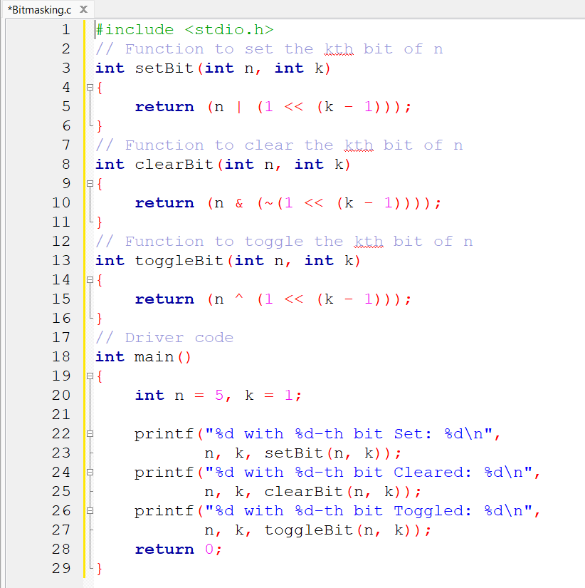
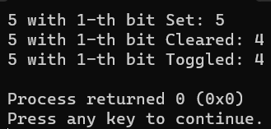
C Code For Set, Clear & Toggle Bit
Output

Slide 22
Practice Problem
Example 1:
Input: N = 19, K = 3
Example 2:
Input: N = 35, K = 4
Example 3:
Input: N = 10, K = 2
Example 4:
Input: N = 42, K = 5
Example 5:
Input: N = 128, K = 7
Example 6:
Input: N = 7, K = 0
Example 7:
Input: N = 240, K = 3
Example 8:
Input: N = 51, K = 1
Example 9:
Input: N = 11, K = 2
Example 10:
Input: N = 36, K = 6

Slide 23
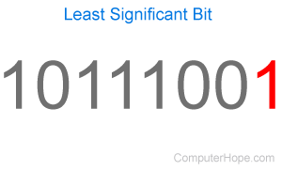
LSB
The Least Significant Bit (LSB) is the rightmost bit in a binary representation of a number.
Example to illustrate the concept of the LSB:

Slide 24
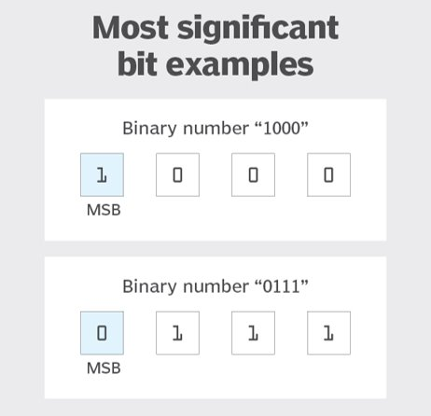
MSB
The Most Significant Bit (MSB) is the leftmost bit in a binary representation of a number.
Here's an example to illustrate the concept of the MSB:

Slide 25
Application Of Set Operations
Set are used in the music player app to list all the songs in proper order.
Set are used to determine the distinct values in an array.
Set are used to detect cycles in a Linked List.
Sets are used in various database operations such as performing joins

Slide 26
References
https://geeksforgeeks.org/bitwise-operators-in-c-cpp/
https://www.javatpoint.com/bitmask-in-cpp#:~:text=You%20can%20also%20use%20bitmasking,%7C%20(1%20%3C%3C%203)%3B
https://www.scaler.com/topics/data-structures/bit-masking/

Slide 27
Thank You

